Slide 1
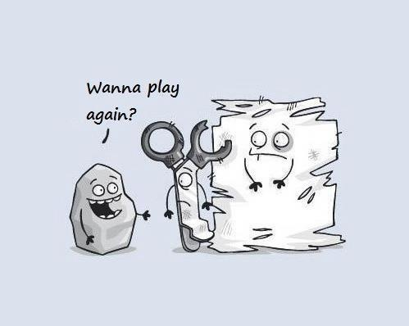
STONE PAPER SCISSORS IN PYTHON
This is a project of STONE PAPER SCISSORS Game programmed in python

Slide 2

Objective:
01 Provide a user-friendly interface for players to enjoy
the game.
02 Develop a simple yet engaging implementation of the
classic Stone Paper Scissors game using Python.

Slide 3
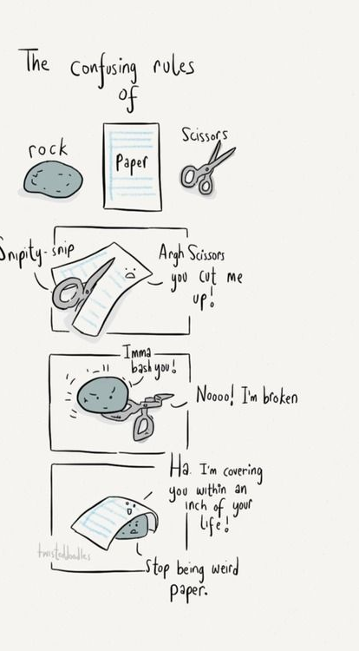
Algorithm :
01 Initialize scores: Set both user and computer scores to 0.
02 Prompt user input: Ask the user to enter 'rock', 'paper’,
'scissor', or 'q' to quit.
03 Randomly select an option for the computer from the list
of moves.
04 If the user and computer choices are the same, it's a draw
( skip to the next round).
05 Game over:
01 Display the final scores.
02 Print a goodbye message.

Slide 4
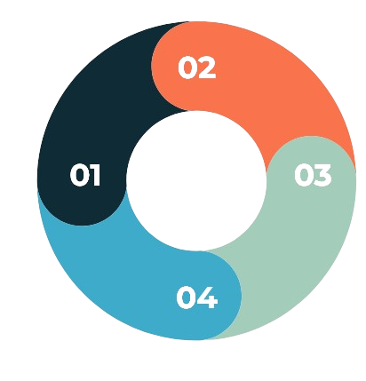
The random module is a standard Python library used to generate random numbers,
The random module is a standard Python library used to generate random numbers,
Tech Stack Used :
Programming Language: Python
User Interface: Basic
console input/output.
Random Module : The Random
Module is used to generate
Random Number.
Logic : The code utilizes Loop
and Conditional statement

Slide 5

Future Scope :
AI Opponent: Develop an
artificial intelligence opponent
for single-player mode.
User Interface: Basic
console input/output.
Data Structures: Lists
to store game states.
Logic: Decision-making based
on winning combinations.

Slide 6
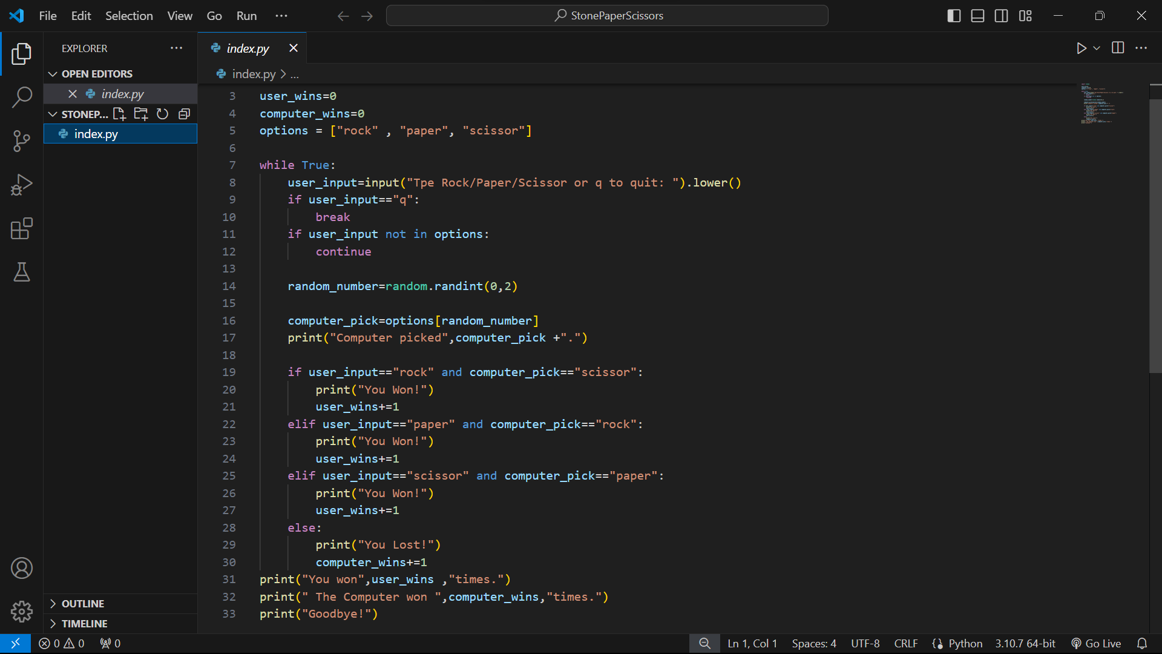
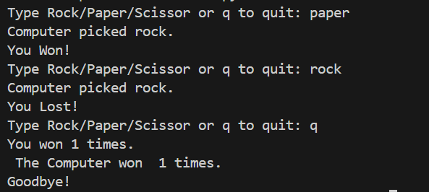
Screenshots

Slide 7
Thank you

